Slide 1

FlowCastAI: Predicting Traffic with Machine Learning
A data-driven framework for forecasting hourly traffic volume across New South Wales by combining vehicle count data with station-level metadata and weather conditions.

Slide 2




Project Overview
Data Integration
Machine Learning
Weather Awareness
Historical traffic records + station metadata
Predict traffic volume with road characteristics impact
Environmental conditions affect traffic patterns

Slide 3




Problem Statement
Sub-problem A: Baseline Prediction
Learn traffic trends using temporal features
Sub-problem B: Weather Impact
Learn how weather modifies baseline traffic
Combined Solution
Vpredicted = Vbaseline + Weather Effect

Slide 4
Data Pre-Processing
Traffic Data
Weather Data
Missing values handled
Key features extracted
Timestamps structured
Geospatial matching
Quality stations filtered
Missing data interpolated

Slide 5
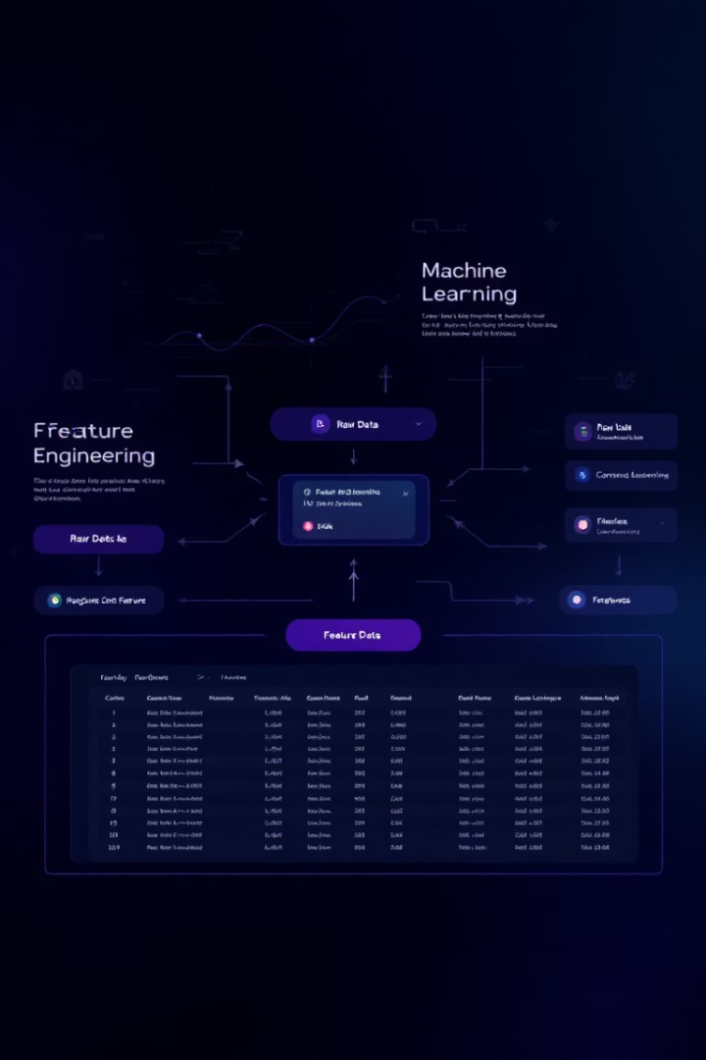
Feature Extraction
Temporal Features
Environmental Features
Hour, day, month, holidays
Rainfall, min/max temperature
Encoding Methods
Categorical encoding, standardization

Slide 6

Model Selection
Model Type
Strengths
Weaknesses
Random Forest
Non-linear, resistant to overfitting
Misses time dependencies
XGBoost
High performance, handles missing data
Complex tuning needed
Neural Networks
Complex patterns, flexible inputs
Requires large datasets

Slide 7








Weather Impact Analysis
Rainfall
Maximum Temperature
Influences road conditions and driving behavior
Affects comfort and travel patterns
Minimum Temperature
Traffic Adjustment
Impacts morning commute conditions
Weather-aware volume prediction

Slide 8






Business Applications
Smart City Integration
Future-proof urban planning
Adaptive Traffic Systems
Real-time signal optimization
Navigation Platforms
Enhanced route recommendations

Slide 9

Revenue Potential
$2.5M
15%
Infrastructure Savings
Efficiency Gain
Reduced congestion costs
Improved traffic flow
$1.2M
Licensing Revenue
API access for developers

Slide 10



Next Steps
Scale deployment
Expand to additional regions
Real-time integration
Live data feeds and API development
Partner engagement
Transportation agencies and navigation platforms

